Slide 1
Intelligent Techniques for Automated Tesing on Web and Mobile Applcations
網頁和手機程式自動化測試智能技術
學生: 吳啟允 Chi-Yu, Wu
指導教授：王 凡
電機所碩二 計算機科學組
中華民國105年7月

Slide 2
Contents
Introduction
Related Works
Preliminaries
WebTraceCollector
Trace Evaluation
Experiments
Conclusion

Slide 3
Contents
Introduction
Related Works
Preliminaries
WebTraceCollector
Trace Evaluation
Experiments
Conclusion
Notes:
aaa

Slide 4
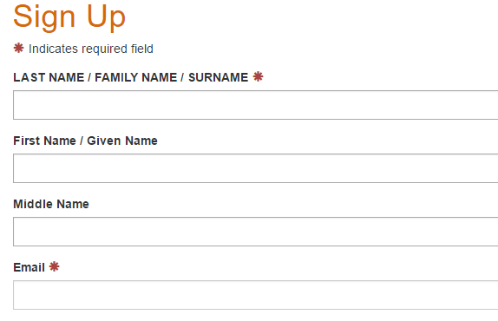
Introduction - Motivation
Challenges on web testing
Too hard to do black box testing on dynamic webpage .

Slide 5
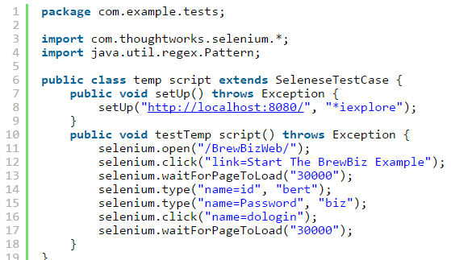
Introduction - Motivation
Challenges on web testing
Writing test scripts costs lots of time.

Slide 6




Introduction - Motivation
Platform of applications
Some applications are developed on the Internet and mobiles.
Similar behaviors and results.

Slide 7
Introduction - Purpose
Develop a testing tool
Automatic testing web applications.
Working on dynamic web applications.
Evaluation method
Representing traces by the common sense label.
Predicting Web traces and Mobile traces.

Slide 8
Contents
Introduction
Related Works
Preliminaries
WebTraceCollector
Trace Evaluation
Experiments
Conclusion

Slide 9
Related Works
Web testing
Jmeter
Crawljax
browsera
Test Evaluation
#TODO

Slide 10
Contents
Introduction
Related Works
Preliminaries
WebTraceCollector
Trace Evaluation
Experiments
Conclusion

Slide 11
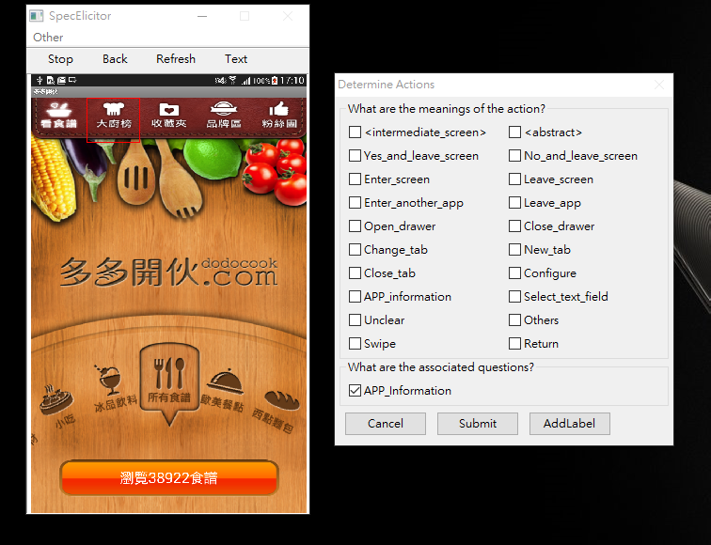
Preliminaries - SpecElicitor
Tool for testing Mobile Applications, developed by Yuan-Hong Lo.
Record the label of screen and action.
Build a common sense model.
Ouptut the traces with labels.

Slide 12




Preliminaries - Common sense label
Generalize similar behaviors
Represent common sense by normalized terms
Open Note
Write Note
Save Note
Close Note
Create Note
Write Note
Send Note
Open Note
Copy paste
Close Note
Delete Note

Slide 13
Preliminaries - Label dictionary
Example of label dictionary of Note applications.
Screen Labels | Action Labels
Note | Save note
Note list | Create note
Save query | Open note
Delete query | Edit note
Search query | Delete note
Note infomation | Send note
 | Search note

Slide 14
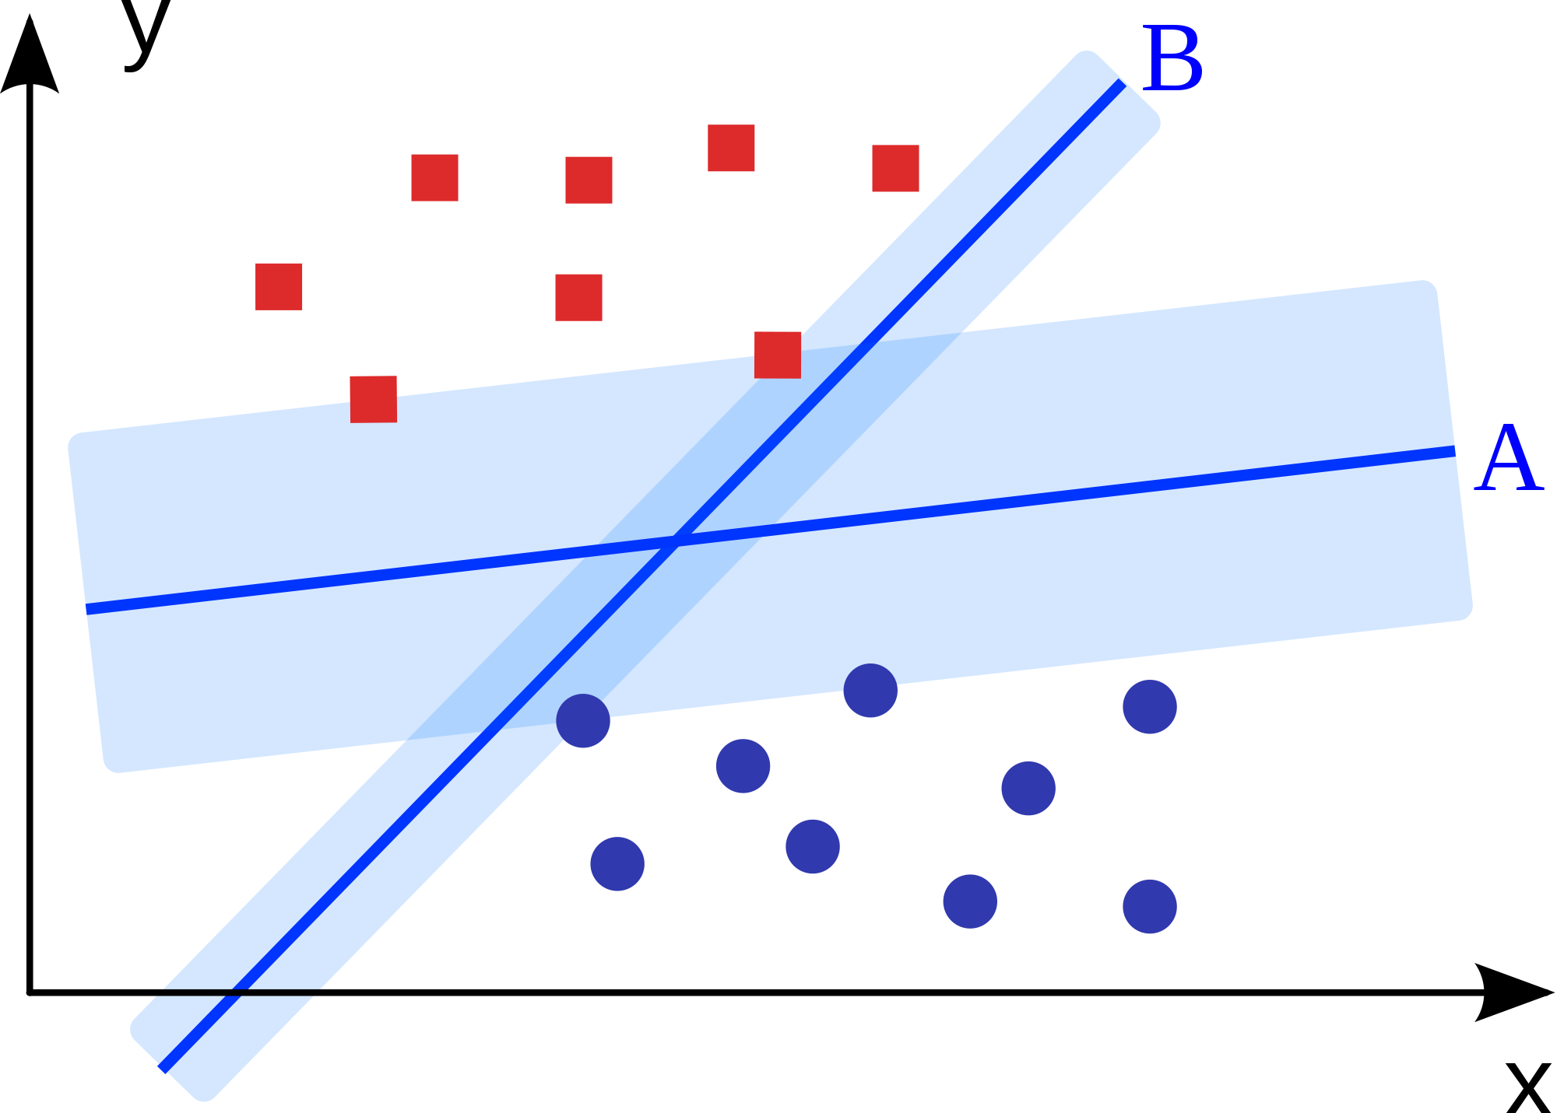
Preliminaries - Machine learing
Support Vector Machine
Finding a optimal hyper-plane by largest marign to seperate datas.
Classifying traces into Pass and Fail.

Slide 15
Contents
Introduction
Related Works
Preliminaries
WebTraceCollector
Trace Evaluation
Experiments
Conclusion

Slide 16
WebTraceCollector - Overview
Input fields
Database
Event list
Get Event
Suggested value
Insert value
Click element
DOM infomation
Automata
Change state
New state
Add Event

Slide 17
WebTraceCollector - Event definition
Get event infomation from event list.
State
Depth
Clickable
Only one clickable in one event
Input fields
Depends on the DOM tree of target state
May be 1 inputs, 0 or more inputs.

Slide 18
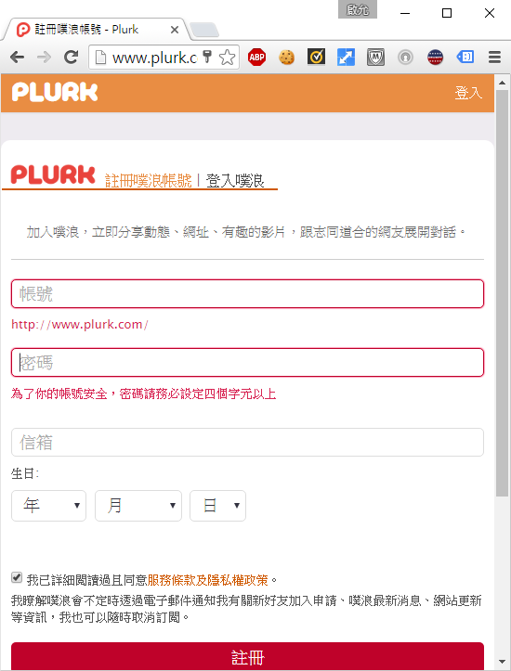

WebTraceCollector - Event
Go to the target state.
Choose the clickable element.

Slide 19


WebTraceCollector - Event
Find input fields from the state.

Slide 20
WebTraceCollector - Event
Analyze the input field and get the suggested value.
Bobsky123
Qwerty0123
Bob@gmail.com
2001
6
29

Slide 21
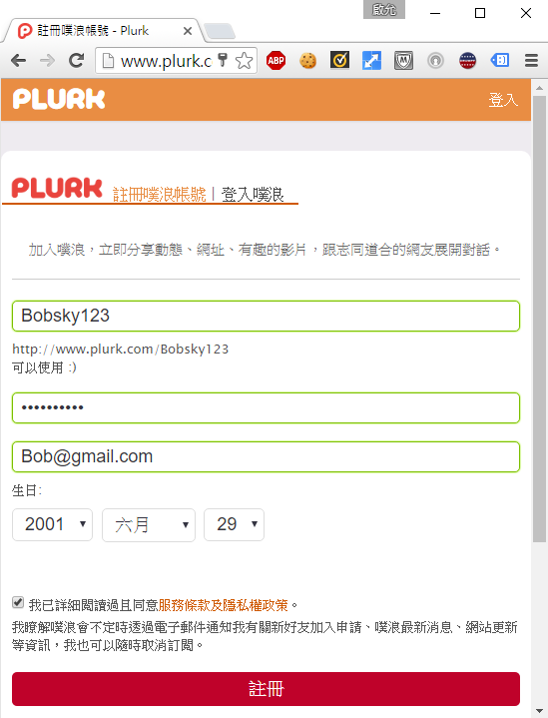
WebTraceCollector - Event
Insert values into input fields.
Bobsky123
Qwerty0123
Bob@gmail.com
2001
6
29

Slide 22
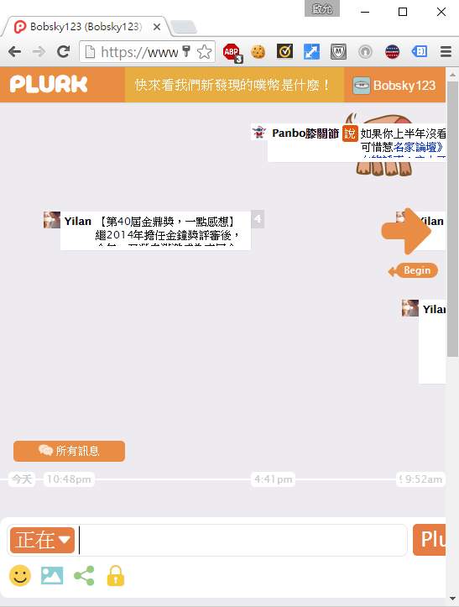
WebTraceCollector - Event
Click
6
29

Slide 23
WebTraceCollector - Database
Collect examples of inputs.
name / 名字 | Ann | Bob | Cindy
email / 信箱 | Ann@hotmail.com.tww | Bob@gmail.com | Cindy@yahooo.com
job / 職業 | student | engineer | officer
gender / 性別 | man | woman
phone / 電話 | 0900123456 | 0987654321 | 0911001011
address / 地址 | #12 abc street Tainan Taiwan | 5 floor #12 sun street Pintung Taiwan | # USA ,orange,2323
birth / 生日 | 2001/02/03 | 1999/04/03 | 1992/04/07

Slide 24
WebTraceCollector - Database
Analyze the input field.
name
id
type
class
sibling text
name / 名字
email / 信箱
job / 職業
gender / 性別
phone / 電話
address / 地址
birth / 生日

Slide 25
WebTraceCollector - Database
Randomly choose a value as input.
email / 信箱 | Ann@hotmail.com.tww | Bob@gmail.com | Cindy@yahooo.com
Bob@gmail.com

Slide 26
WebTraceCollector - Update
Notes:
ㄇ

Slide 27
Contents
Introduction
Related Works
Preliminaries
WebTraceCollector
Trace Evaluation
Experiments
Conclusion

Slide 28
Trace Evaluation
- Procedure
Passed trace
SVM
Predict
Model
Failed trace
Train
Test
Web
Traces
Vectors
Unlabeled
Training set
Testing set
Mobile
Labeled
Parse

Slide 29
Trace Evaluation - Parsing traces
Web traces
Find the Keywords in the DOM tree of the state.
Find the Keywords in the clickable element of the edge.
Android traces
Find the labels from the traces generated by SpecElicitor.

Slide 30
Trace Evaluation - Parsing traces
Screen Labels | Action Labels
Note | Save note
Note list | Create note
Save query | Open note
Delete query | Edit note
Search query | Delete note
Note infomation | Send note
 | Search note
Construct a standard format by label dictionary
Feature
Vector
Create Note
Open Note
Write Note
Save Note
Delete Note
Close Note

Slide 31
Trace Evaluation - Parsing traces
Construct a standard format by label dictionary
Feature
Vector
Create Note
Open Note
Write Note
Save Note
Delete Note
Close Note
Trace
Open Note
Write Note
Save Note
Write Note
Close Note
Vector
0
1
2
1
0
1

Slide 32
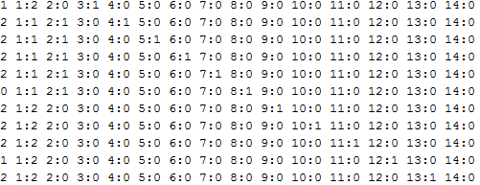
Trace Evaluation - Parsing traces
An example of vector of traces

Slide 33
Trace Evaluation - Training Model
Greedy sampling the trace each time.
Count the total labels of the training set
Add the trace that can maximize the label amount of training set.
Date set
Training set
A, B, G
A, C, D
A , B , C
maximize
B ,D, F
D, G, F
B , E , F

Slide 34
Contents
Introduction
Related Works
Preliminaries
WebTraceCollector
Trace Evaluation
Experiments
Conclusion

Slide 35
Experiments - Design
Environment
Windows10
Python3.4.3
Mysql database
Trace collection
Monkey traces and DFS traces
Dynamic webpage
Trace evaluation
#TODO

Slide 36
Experiments - Trace collection
Monkey traces
Quickly make simple traces.
Add one event each time.
Choose a clickable randomly.
A trace may have a loop.
DFS traces
Guarantee to click every clickable elements.
Add all events in the state.
Add an event when a new state occurs only.

Slide 37
Experiments - Trace collection
類別 | URL | Result | Automata
論壇 | http://www.gamer.com.tw/ | Pass, Complex domain | Some state error
論壇 | http://ck101.com/ | Pass, Complex Iframe | Some state error
論壇 | http://mobile01.com/ | Pass | Some state error
購物網 | http://shopping.pchome.com.tw/ | Pass, One unkown Fail | Some state error
新聞 | http://pansci.asia/ | Fail, Complex clickables and Iframe
部落格 | http://blog.justfont.com/ | Pass, Backtrack error | Pass
部落格 | https://www.python.org/ | Pass | Pass
部落格 | https://app.kxg.io/ | Pass, One unkown Fail | Pass

Slide 38
Experiments - Trace collection
網站 | URL | Result | Automata
影音 | https://www.youtube.com/ | Fail, Complex clickables and Iframe
漫畫 | http://www.comico.com.tw/ | Pass | Pass
字典 | http://dict.revised.moe.edu.tw/cbdic/ | Pass | State error
食譜 | http://www.dodocook.com/ | Pass, Backtrack error | State error
歌詞網 | http://mojim.com/ | Fail, Complex clickables and Iframe
 | http://www.ettoday.net/
 | http://www.businessweekly.com.tw/
 | http://www.pchome.com.tw/

Slide 39
Experiments - Trace collection
Dynamic Webpage
URL | Result
http://www.plurk.com/signup | Pass
https://ups.moe.edu.tw/Personal_Page/index.php | Pass
https://applyweb.collegenet.com/account/new/create | Pass
https://apply.grad.ucsd.edu/signup | Pass
https://user.gamer.com.tw/regS1.phpt | Fail, Image recognize
http://panel.pixnet.cc/signup/step2 | Fail, Robot check
https://apps.grad.uw.edu/applForAdmiss/newUserProfile.aspx?bhcp=1 | Fail, Find no example

Slide 40
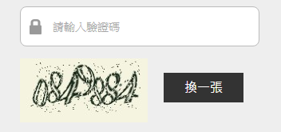
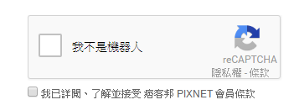
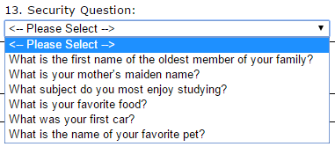
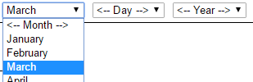
Experiments - Trace collection
Failure reason
Robot check
Input fields cannot find examples in database
Wrong example style
birth / 生日 | 2001/02/03 | 1999/04/03 | 1992/04/07

Slide 41
Experiments - Trace evaluation
#TODO

Slide 42
Contents
Introduction
Related Works
Preliminaries
WebTraceCollector
Trace Evaluation
Experiments
Conclusion

Slide 43
Conclusion - Summary
Tool for web automatic testing.
Generate monkey traces and DFS traces.
Handle dynamic web pages with input fields.
Guess the input value by examples.
Method for predicting passed trace and failed trace.
Convert traces to vector format.
Train SVM model to predict traces.

Slide 44
Conclusion - Limitation
Challenges on generating traces
Too many iframes and candidate clickables
Can not find the actually clickable
Too hard to recognize state correctly for building automata
Challenges on analyzing input values
Still need more input examples.
Lack of information to guess the value

Slide 45
Conclusion - Future work
Guess input value correctly
Add more input examples.
Use natural language processing to analyze the input text.

